Slide 1
Software Engineering
Sobia Iftikhar
Sobia.Iftikhar@nu.edu.pk
Week 09

Slide 2
Class 22 07-APRIAL-2021

Slide 3
Content
Architectural design decisions
Architectural views
Architectural patterns
Application architectures

Slide 4
Pipe & Filter Architecture
Pipe and Filter is another architectural pattern.
which has independent entities called filters (components) which perform transformations on data and process the input they receive,
and pipes, which serve as connectors for the stream of data being transformed, each connected to the next component in the pipeline.
Many systems are required to transform streams of discrete data items, from input to output.
Many types of transformations occur repeatedly in practice, and so it is desirable to create these as independent, reusable parts, Filters

Slide 5
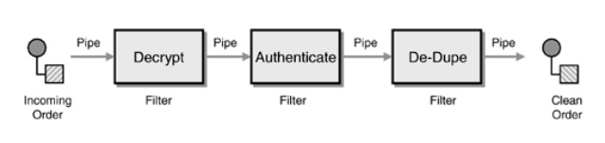
Example
Compilers:
Lexical Analysis -> parsing -> semantic analysis -> code generation
Signal Processing

Slide 6
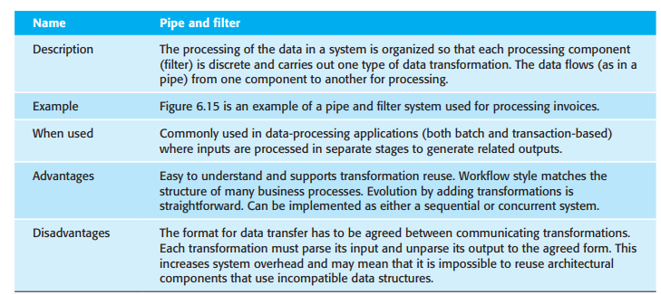
Pattern Name

Slide 7

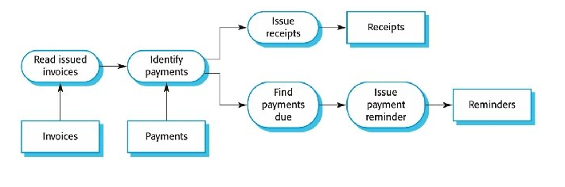
Example
The name “pipe and filter” comes from the original Unix system where it was possible to link processes using “pipes.”
Pipe and filter systems are best suited to batch processing systems and embedded systems where there is limited user interaction.

Slide 8
Application Architecture
Application systems are intended to meet a business or an organizational need. All businesses have much in common—they need to hire people, issue invoices, keep accounts, and so on.
These commonalities have led to the development of software architectures that describe the structure and organization of particular types of software systems.
For example, in real-time systems, there might be generic architectural models of different system types, such as data collection systems or monitoring systems. Although instances of these systems differ in detail.
The application architecture may be reimplemented when developing new systems.

Slide 9
you can use models of application architectures in a number of ways:
For example, a system for supply chain management can be adapted for different types of suppliers, goods, and contractual arrangements
As a starting point for the architectural design process As a design checklist
As a way of organizing the work of the development team
As a means of assessing components for reuse.
As a vocabulary for talking about applications

Slide 10
As a starting point for the architectural design process As a design checklist
If you are unfamiliar with the type of application that you are developing, you can base your initial design on a generic application architecture.
As a means of assessing components for reuse.
If you have components you might be able to reuse, you can compare these with the generic structures to see whether there are comparable components in the application architecture.
As a way of organizing the work of the development team
The application architectures identify stable structural features of the system architectures
As a vocabulary for talking about applications
If you are discussing a specific application or trying to compare applications

Slide 11
Example of Application Architecture
Data processing applications
Data driven applications that process data in batches without explicit user intervention during the processing. E.g scientific data processing, commercial data processing and data analysis.
Transaction processing applications
Data centered applications that process user requests and update information in a system database. E.g. E-commerce processing, bank transfers
Event processing systems
Applications where system actions depend on interpreting events from the system’s environment. E.g wireless sensor applications
Language processing systems
Applications where theusers’intentions are specified in a formal language that is processed and interpreted by the system. E.gNatural Language processing

Slide 12
Application type examples
Two very widely used generic application architectures are transaction processing systems and language processing systems.
Transaction processing systems
E-commerce systems;
Reservation systems.
Language processing systems
Compilers;
Command interpreters.

Slide 13
Transaction processing systems
Process user requests for information from a database or requests to update the database.
They are organized in such a way that user actions can’t interfere with each other and the integrity of the database is maintained.
From a user perspective a transaction is:
Any coherent sequence of operations that satisfies a goal;
For example - find the times of flights from London to Paris.
interactive banking systems, e-commerce systems, information systems, and booking systems.
Users make asynchronous requests for service which are then processed by a transaction manager.

Slide 14
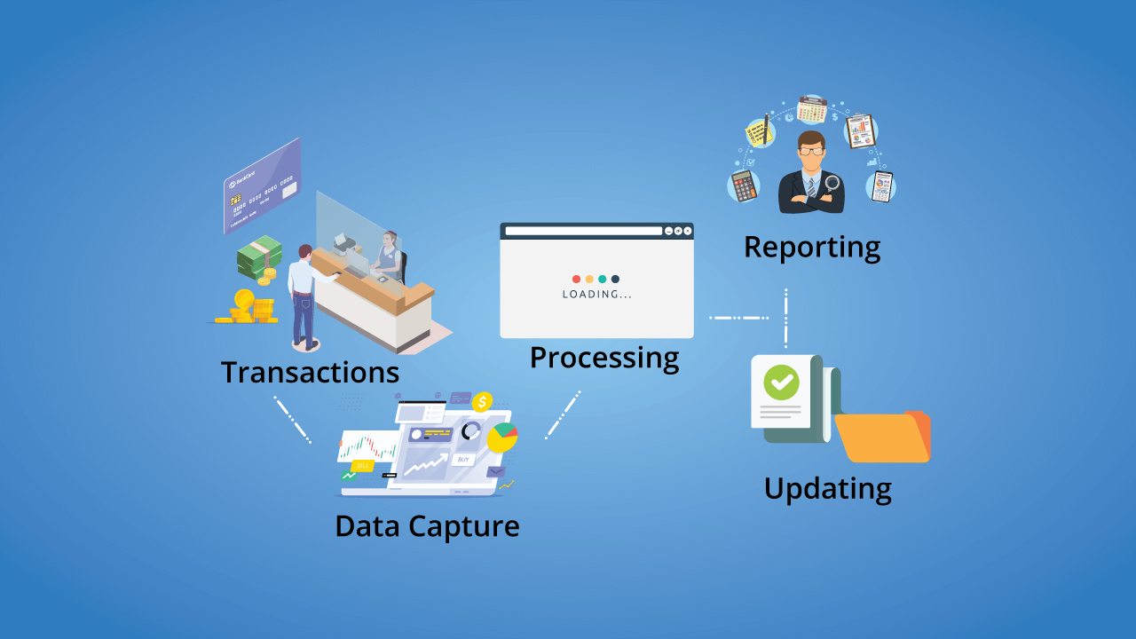
The structure of transaction processing applications

Slide 15
The software architecture of an ATM system

Slide 16
Information systems architecture
Information systems are almost always web-based systems, where the user interface is implemented in a web browser.
All systems that involve interaction with a shared database can be considered to be transaction-based information systems.
such as a library catalog, a flight timetable, or-the records of patients in a hospital. Information

Slide 17
Information systems architecture
Information systems have a generic architecture that can be organized as a layered architecture.
Layers include:
The user interface
User communications
Information retrieval
System database

Slide 18
Layered information system architecture

Slide 19
The architecture of the Mentcare system

Slide 20
Web-based information systems
Information and resource management systems are now usually web-based systems where the user interfaces are implemented using a web browser.
For example, e-commerce systems are Internet-based resource management systems that accept electronic orders for goods or services and then arrange delivery of these goods or services to the customer.
In an e-commerce system, the application-specific layer includes additional functionality supporting a ‘shopping cart’ in which users can place a number of items in separate transactions, then pay for them all together in a single transaction.

Slide 21
Server implementation
These systems are often implemented as multi-tier client server/architectures (discussed in Chapter 17)
The web server is responsible for all user communications, with the user interface implemented using a web browser;
The application server is responsible for implementing application-specific logic as well as information storage and retrieval requests;
The database server moves information to and from the database and handles transaction management.

Slide 22
Language processing systems
Language processing systems are systems in which the user’s intentions are expressed in a formal language, such as a programming language.
The language processing system processes this language into an internal format and then interprets this internal representation. T
he best known language processing systems are compilers,
which translate high-level language programs into machine code.
However, language processing systems are also used to interpret command languages for databases and information systems, and markup languages such as XML.

Slide 23
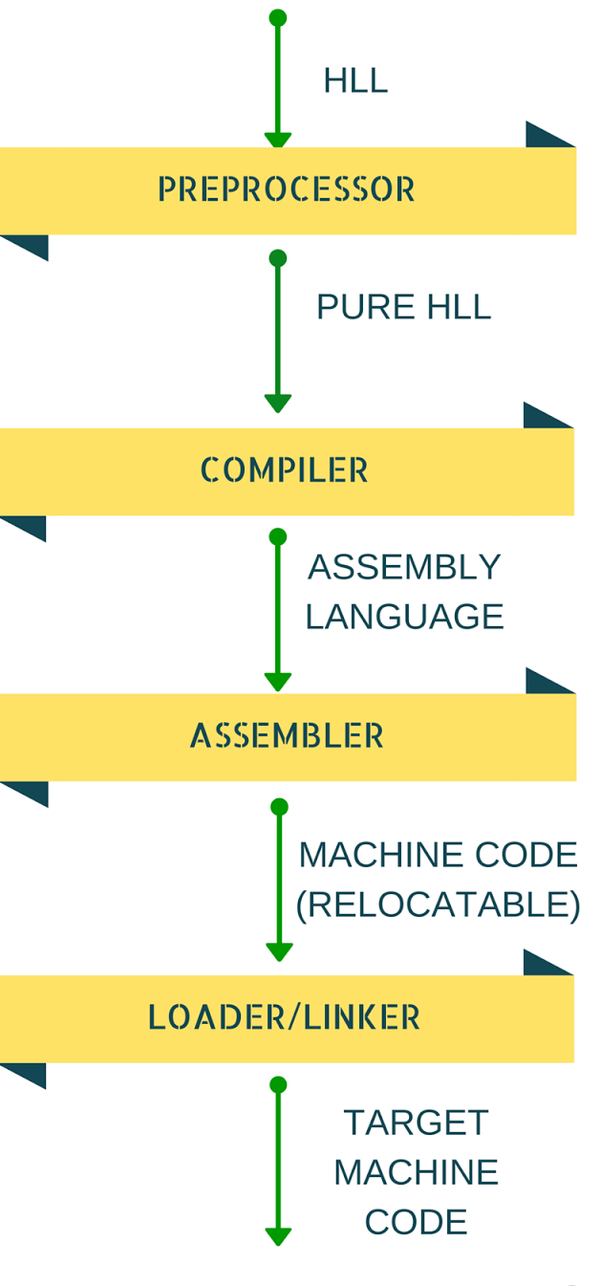

Slide 24
The architecture of a language processing system

Slide 25
Compiler components
A lexical analyzer, which takes input language tokens and converts them to an internal form.
A symbol table, which holds information about the names of entities (variables, class names, object names, etc.) used in the text that is being translated.
A syntax analyzer, which checks the syntax of the language being translated.
A syntax tree, which is an internal structure representing the program being compiled.

Slide 26
Class 23 08-APRIAL-2021

Slide 27
Chapter #11 User Interface Design
The Golden Rules
Place the User in Control
Reduce the User’s Memory Load
Make the Interface Consistent
User Interface Analysis and Design
Interface Analysis and Design Models
The Process
Interface Analysis
User Analysis
Task Analysis and Modeling
Analysis of Display Content
Analysis of the Work Environment
Interface Design Steps
Applying Interface Design Steps
User Interface Design Patterns
Design Issues
Web App Interface Design
Interface Design Principles and Guidelines Interface Design Workflow for Web Apps
Design Evaluation

Slide 28
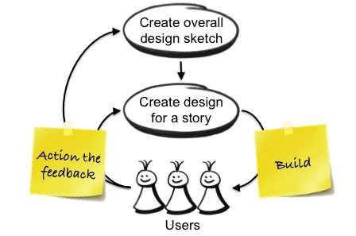
Introduction

Slide 29
Why Should You Care about Interface Design Principles?
Interface inconsistency can cost a big company millions of dollars in lost productivity.
The software becomes more popular if its user interface is:
Attractive
Simple to use
Responsive in short time
Clear to understand
Consistent on all interfacing screens

Slide 30

Background
Interface design focuses on the following
The design of interfaces between software components
The design of interfaces between the software and other nonhuman producers and consumers of information
The design of the interface between a human and the computer
Graphical user interfaces (GUIs) have helped to eliminate many of the most horrific interface problems
However, some are still difficult to learn, hard to use.
User interface analysis and design has to do with the study of people and how they relate to technology

Slide 31

The Golden Rules
1. Place the user in control.
2. Reduce the user’s memory load.
3. Make the interface consistent.

Slide 32
Place the user in control
Provide for flexible interaction
Example
Because different users have different interaction preferences, choices should be provided. For example, software might allow a user to interact via keyboard commands, mouse movement, a digitizer pen, a multitouch screen, or voice recognition commands
Define interaction modes in a way that does not force a user into unnecessary or undesired actions.
Example
If spell check is selected in a word-processor menu, the software moves to a spell-checking mode. There is no reason to force the user to remain in spell-checking mode if the user desires to make a small text edit along the way. The user should be able to enter and exit the mode with little or no effort.

Slide 33
Place the user in control
Allow user interaction to be interruptible and undoable.
The user should also be able to “undo” any action.
Hide technical internals from the casual user.
The user should not be aware of the operating system, file management functions
Design for direct interaction with objects that appear on the screen
The user feels a sense of control when able to manipulate the objects that are necessary to perform a task in a manner similar to what would occur if the object were a physical thing.

Slide 34
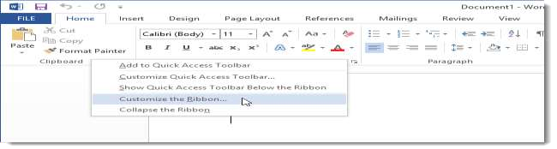
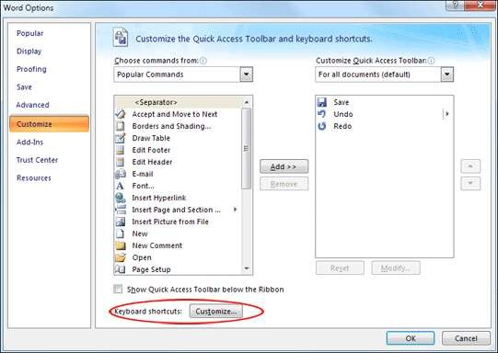
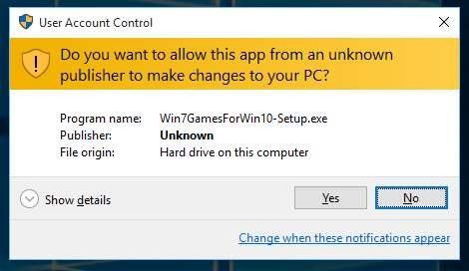
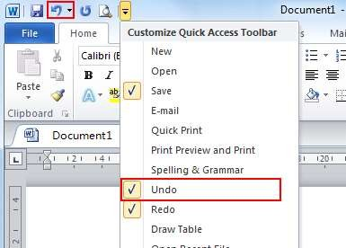
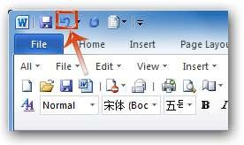
Example

Slide 35
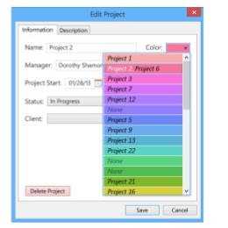
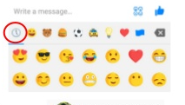
Reduce the user’s memory load.
Reduce demand on short-term memory.
The interface shall reduce the user's requirement to remember past actions and results by providing visual cues of such actions
Establish meaningful defaults
The system shall provide the user with default values that make sense to the average user but allow the user to change these defaults

Slide 36
Reduce the user’s memory load cont.
Define shortcuts that are intuitive
The user shall be provided mnemonics (i.e., control or alt combinations)
The visual layout of the interface should be based on a real-world metaphor
The screen layout of the user interface shall contain well-understood visual cues that the user can relate to real-world actions
Disclose information in a progressive fashion.
When interacting with a task, an object or some behavior, the interface shall be organized hierarchically by moving the user progressively in a step-wise fashion from an abstract concept to a concrete action (e.g., text format options → format dialog box.

Slide 37
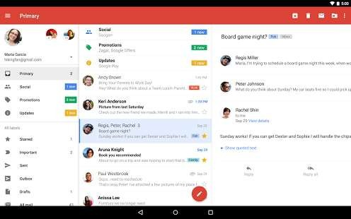
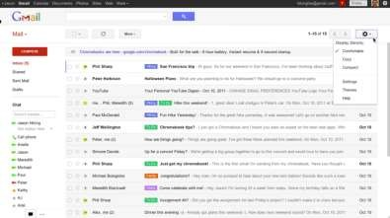
Make the Interface Consistent
Allow the user to put the current task into a meaningful context.
All visual information shall be organized according to a design standard that is maintained throughout all screen displays
Input mechanisms shall be constrained to a limited set that is used consistently throughout the application
Mechanisms for navigating from task to task shall be consistently defined and implemented
.The interface shall provide indicators (e.g., window titles, consistent color coding) that enable the user to know the context of the work at hand

Slide 38
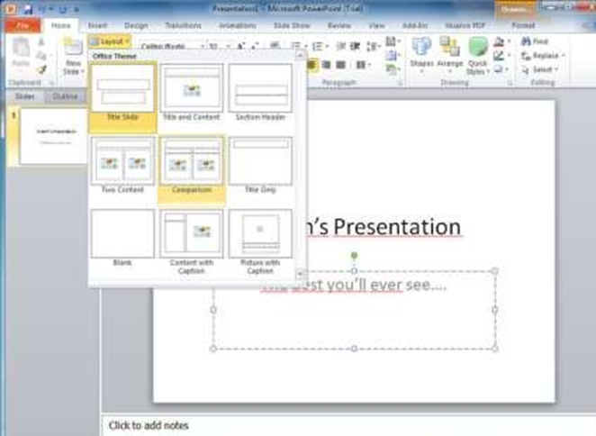
Make the Interface Consistent
Maintain consistency across a family of applications
A set of applications performing complimentary functionality shall all implement the same design rules so that consistency is maintained for all interaction

Slide 39
User Interface Analysis and Design Models

Slide 40
Concepts of Good/Bad Design
Affordances
Perceived properties of an artifact that determines how it can be used (e.g knobs/buttons/slots)
Constraints
Physical, semantic, cultural, and logical factors that encourage proper actions
Conceptual Models
Mental model of system which allows users to:
understand the system
predict the effects of actions
interpret results
Mappings
Describe relationship between controls and their effects on system
Visibility
The system shows you the conceptual model by showing its state and actions that can be taken
Feedback
Information about effects of user's actions

Slide 41
User Interfaces Analysis & Design
Interface Analysis and Design model
Four different models come into play when a user interface is to be analyzed and designed
User Model.
Design Model,
User’s Mental Model
Implementation Model.

Slide 42
1. User Profile Model
Establishes the profile of the end-users of the system
Based on age, gender, physical abilities, education, cultural or ethnic background, motivation, goals, and
Personality
Considers syntactic knowledge of the user
The mechanics of interaction that are required to use the interface effectively
Considers semantic knowledge of the user
The underlying sense of the application; an understanding of the functions that are performed, the meaning of input and output, and the objectives of the system

Slide 43
2. Design Model
Derived from the analysis model of the requirements
Incorporates data, architectural, interface, and procedural representations of the software
Constrained by information in the requirements specification that helps define the user of the system
Normally is incidental to other parts of the design model
– But in many cases it is as important as the other parts
Dialog
Box
Task
Agent
Status
Display
Box
File
Transfer
Agent

Slide 44
3.Implementation Model
Consists of the look and feel of the interface combined with all supporting information (books,
videos, help files) that describe system syntax and semantics
Strives to agree with the user's mental model; users then feel comfortable with the software and use it effectively
Serves as a translation of the design model by providing a realization of the information contained in the user profile model and the user’s mental model

Slide 45
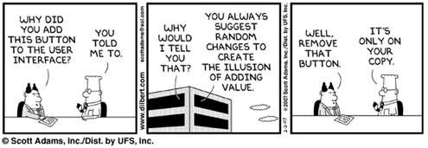
4.User's Mental Model
Often called the user's system perception
Consists of the image of the system that users carry in their heads
Accuracy of the description depends upon the user’s profile and overall familiarity with the software in the application domain

Slide 46
Process
The analysis and design process for user interfaces is iterative and can be represented using a spiral model.
(1) interface analysis and modeling
(2) interface design
(3) interface construction
(4) interface validation.

Slide 47
Interface Design Process
User interface development follows a spiral process
Interface analysis (user, task, and environment analysis)
Focuses on the profile of the users who will interact with the system
Concentrates on users, tasks, content and work environment
Studies different models of system function (as perceived from the outside)
Delineates the human- and computer-oriented tasks that are required to achieve system function
Interface design
Defines a set of interface objects and actions (and their screen representations) that enable a user to perform all defined tasks in a manner that meets every usability goal defined for the system

Slide 48
Analysis of the user environment focuses on the physical work environment.
Question
• Where will the interface be located physically?
• Will the user be sitting, standing, or performing other tasks unrelated to the interface?
• Does the interface hardware accommodate space, light, or noise constraints?
• Are there special human factors considerations driven by environmental factors?

Slide 49
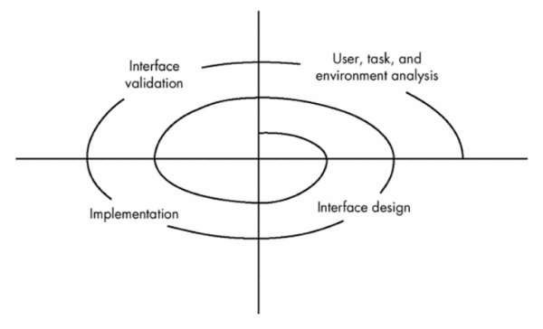
Interface Design Process
Interface construction
Begins with a prototype that enables usage scenarios to be evaluated
Continues with development tools to complete the construction
Interface validation, focuses on
The ability of the interface to implement every user task correctly, to accommodate all task variations, and to achieve all general user requirements
The degree to which the interface is easy to use and easy to learn
The users' acceptance of the interface as a useful tool in their work

